Slide 1
ML Cards Overview

Slide 2
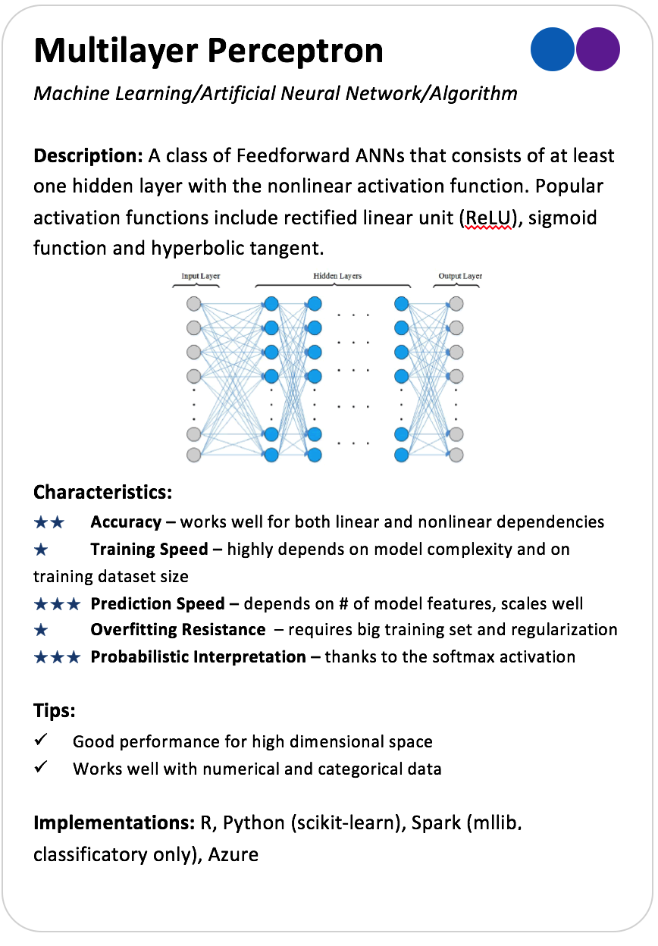
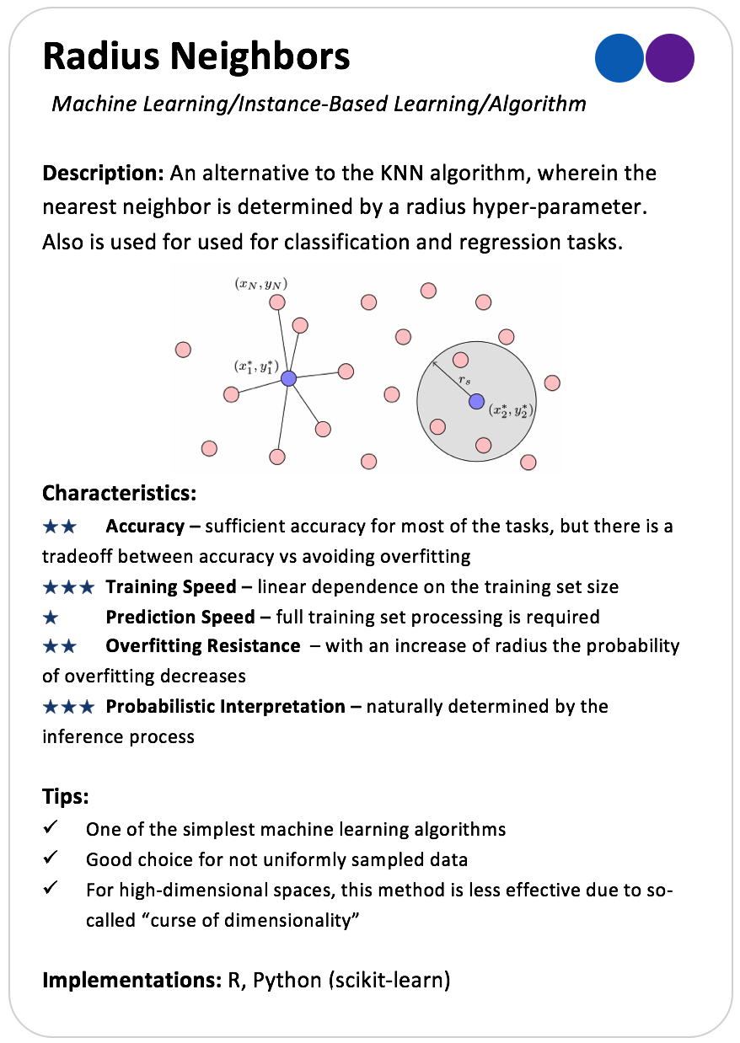
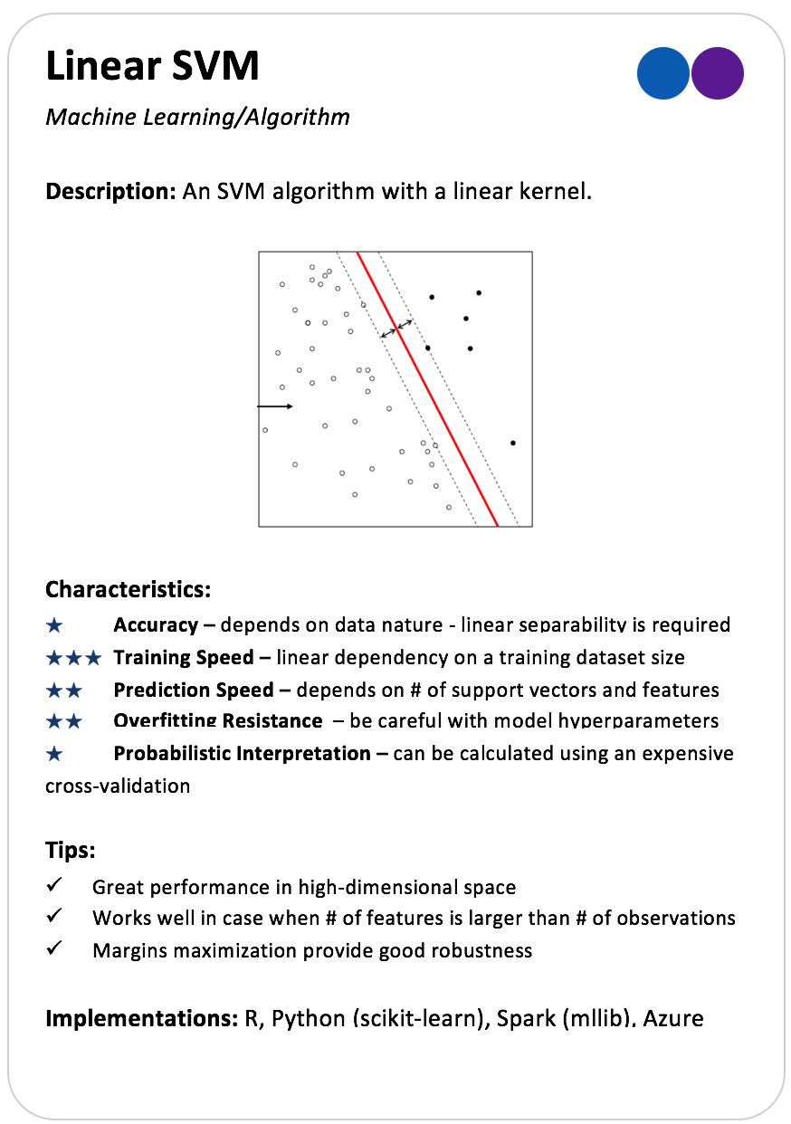
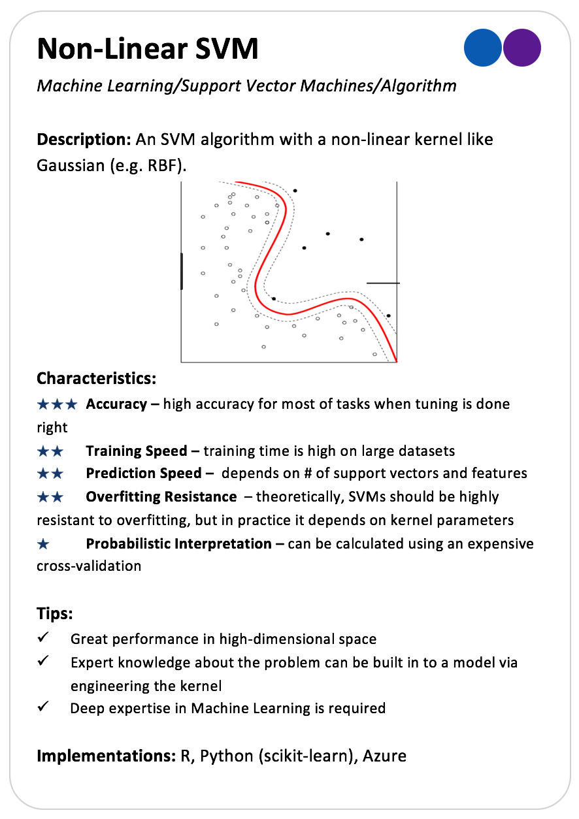
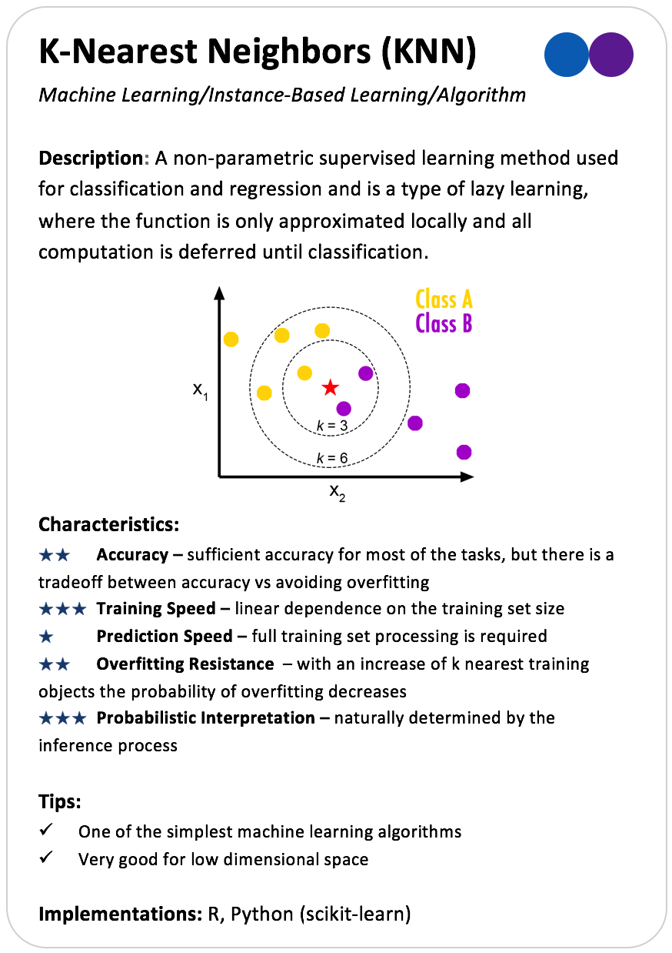
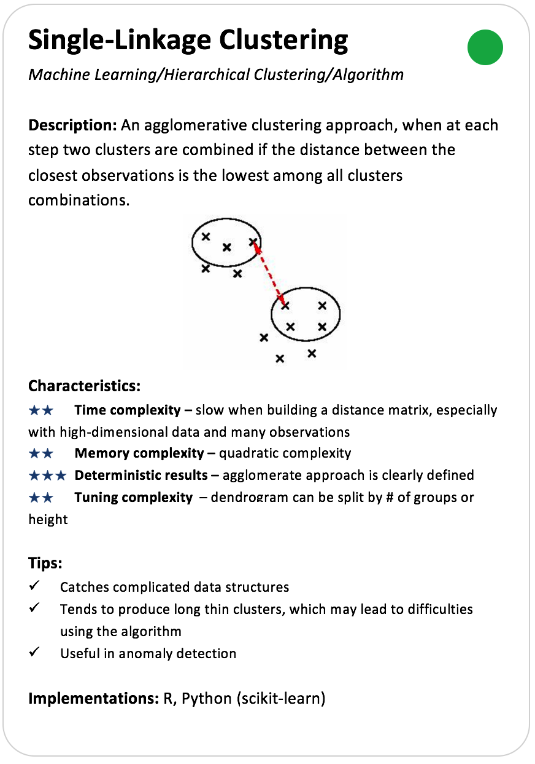
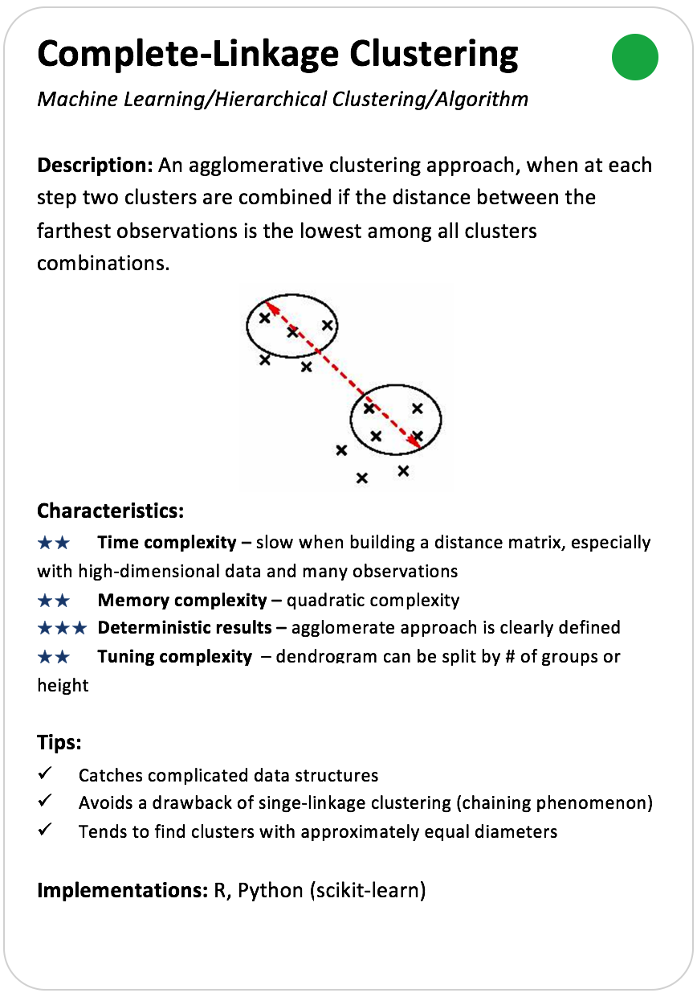
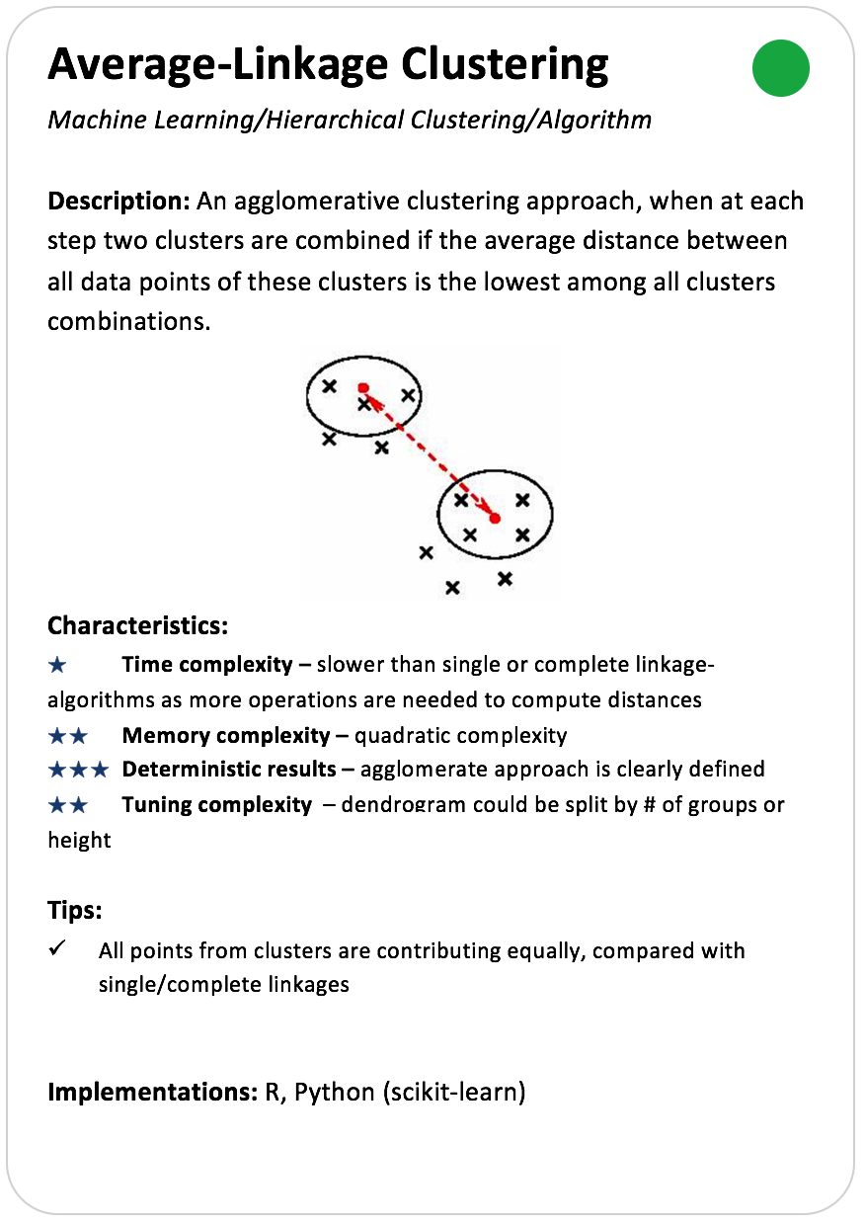
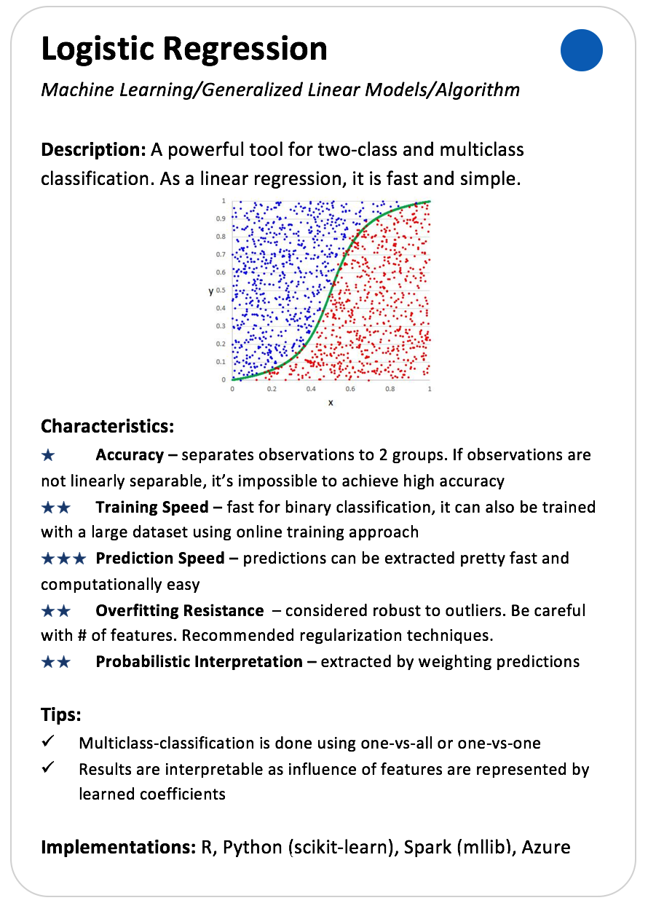
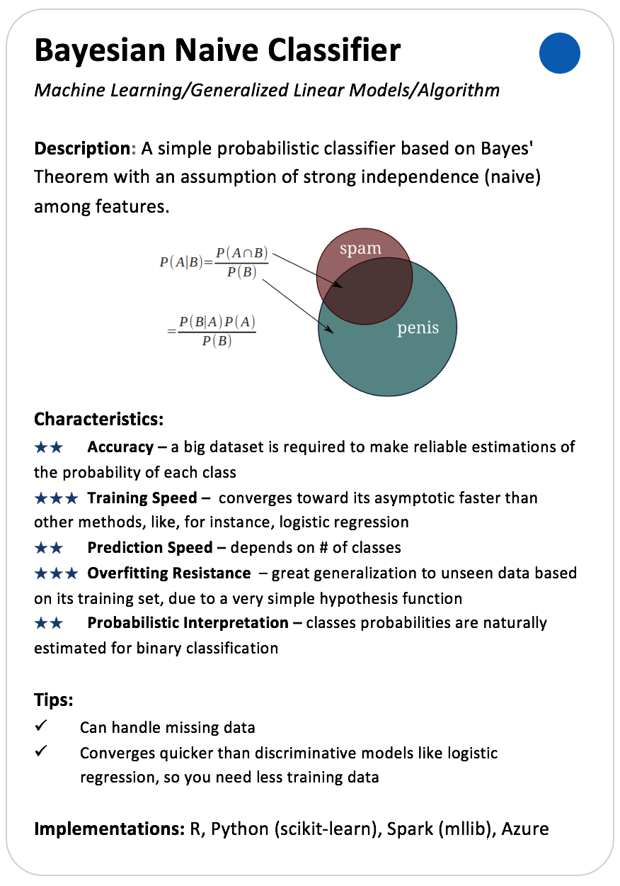
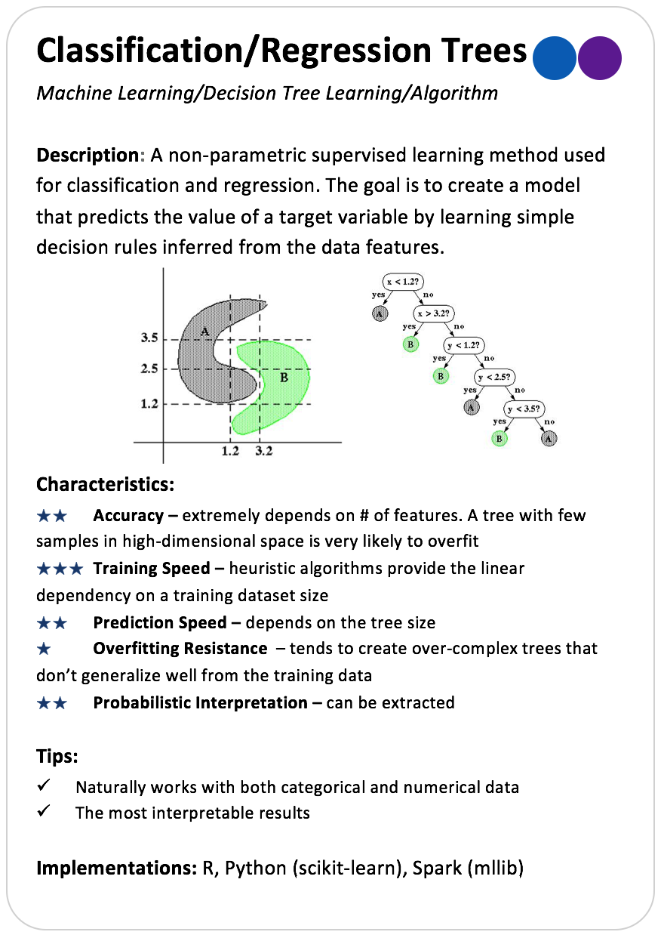
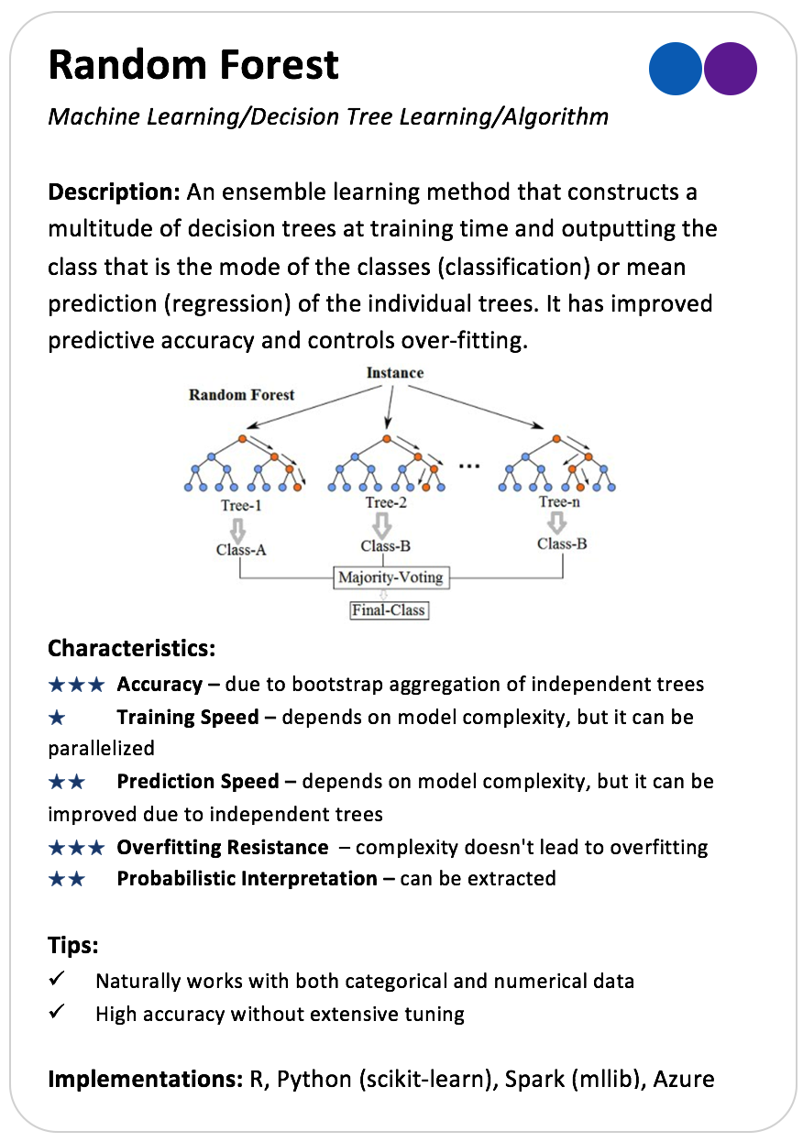
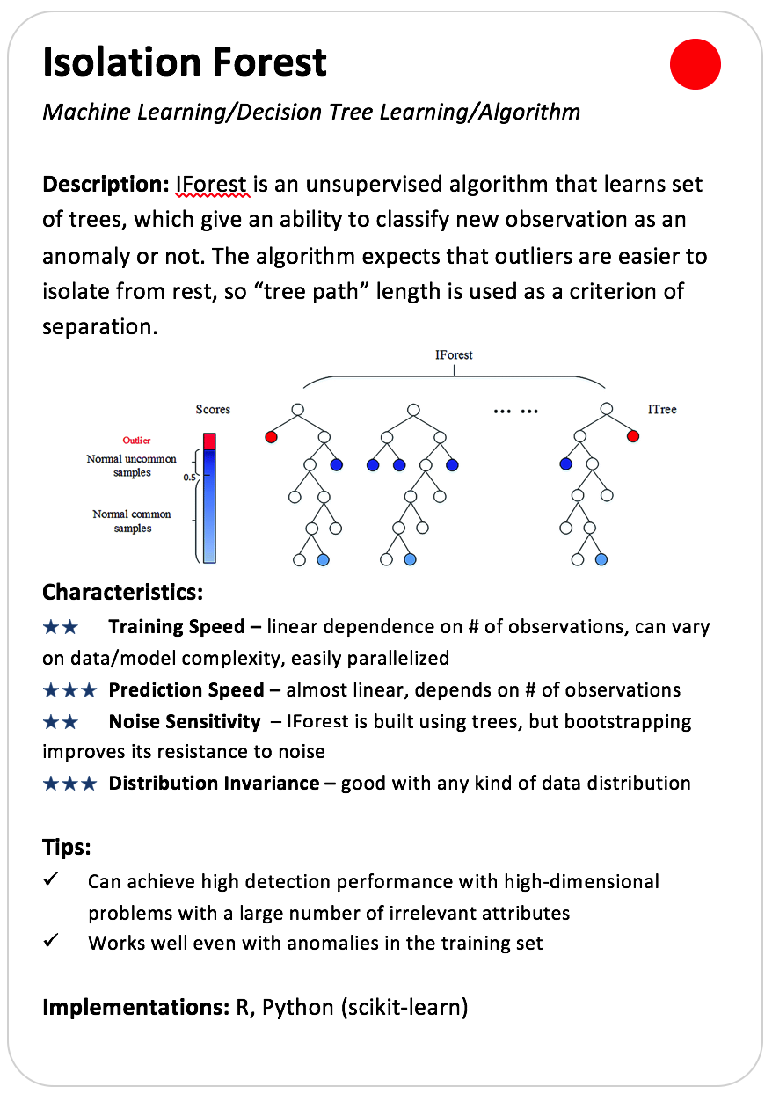
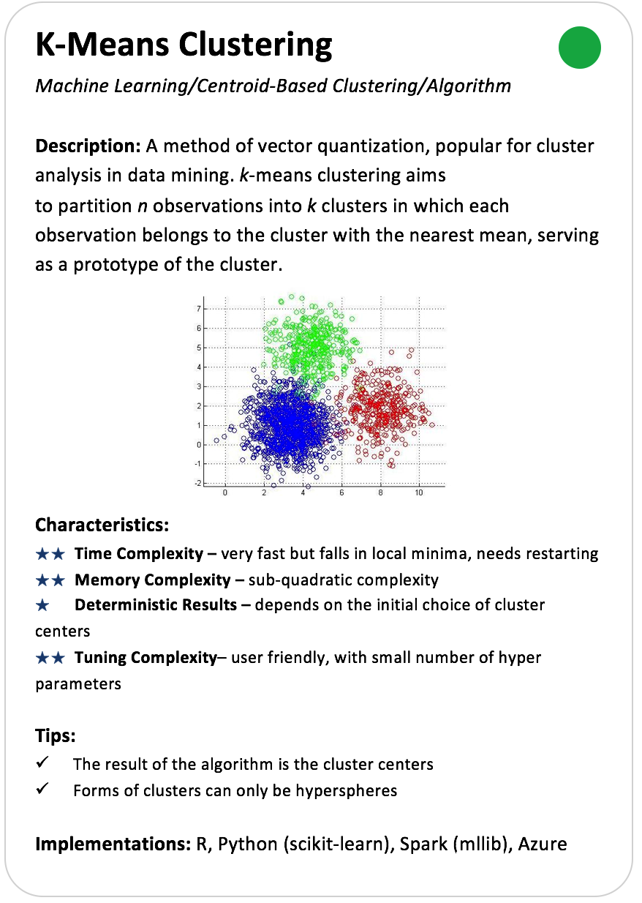
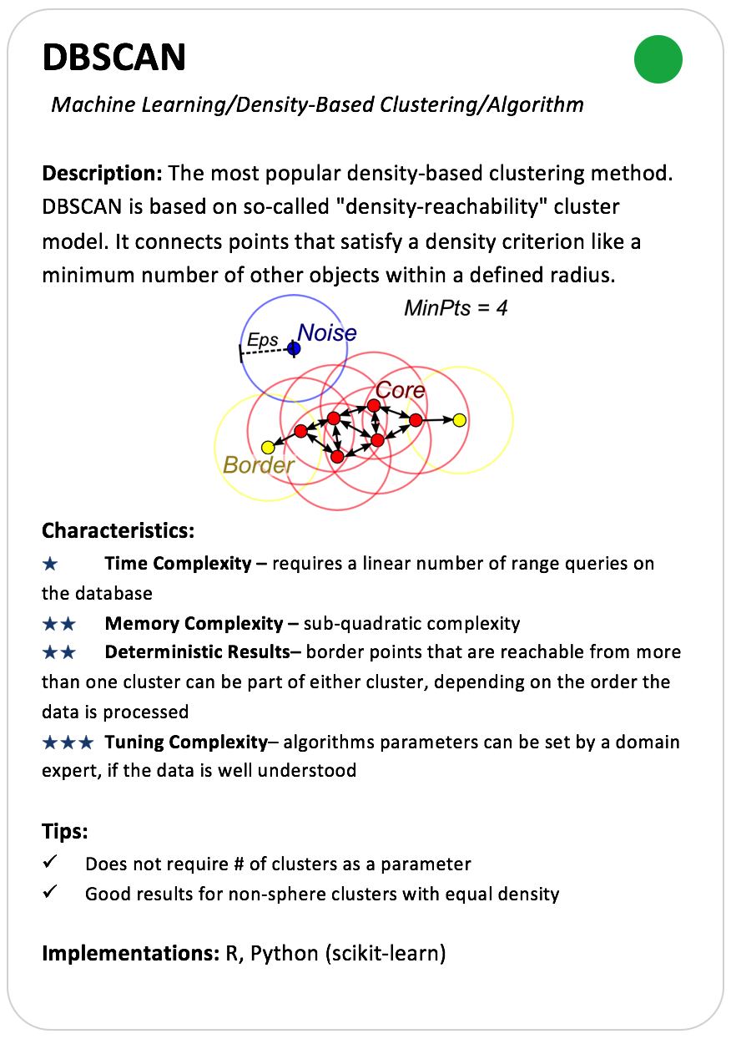
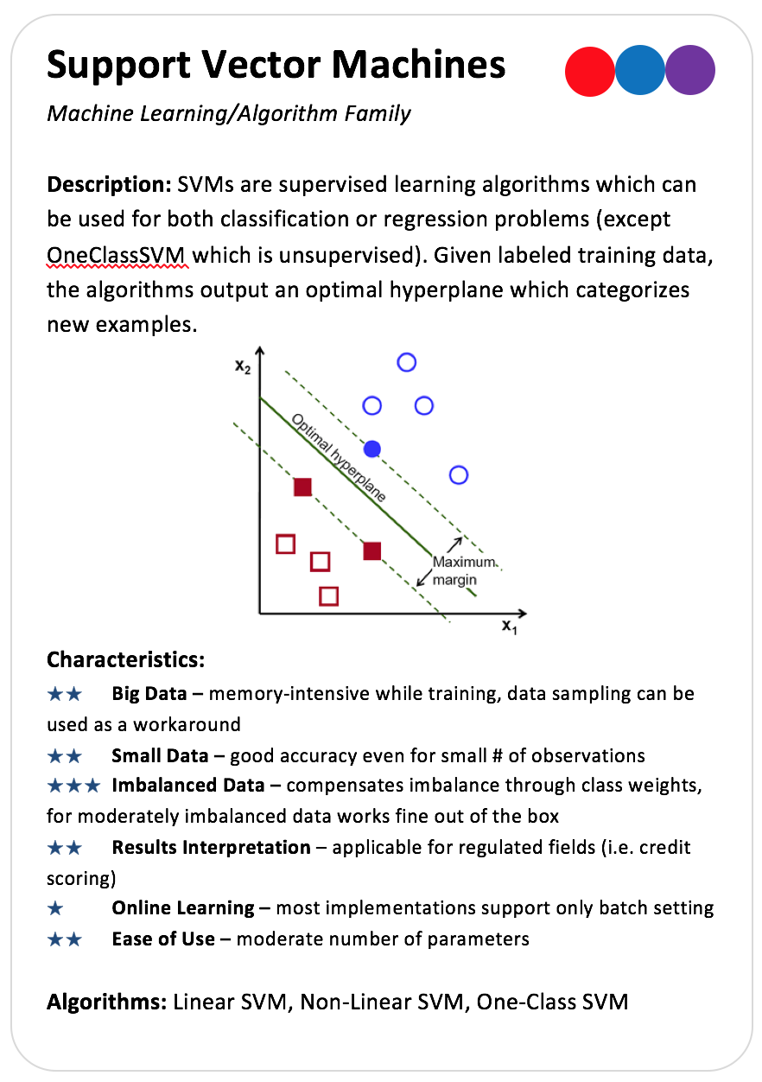
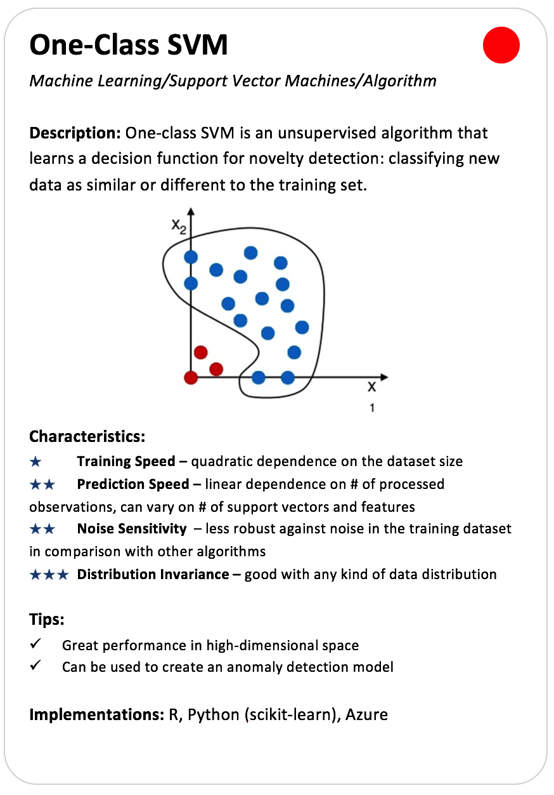
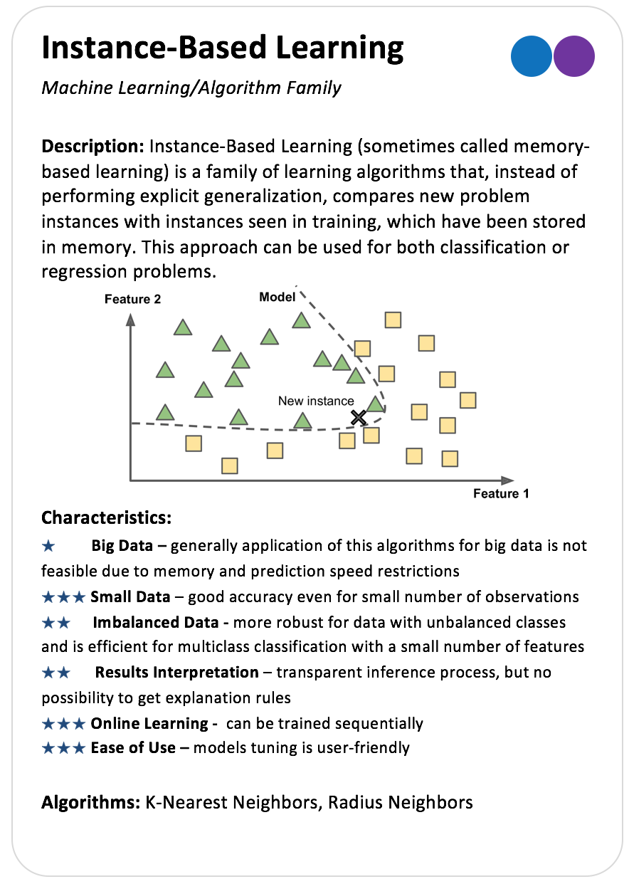
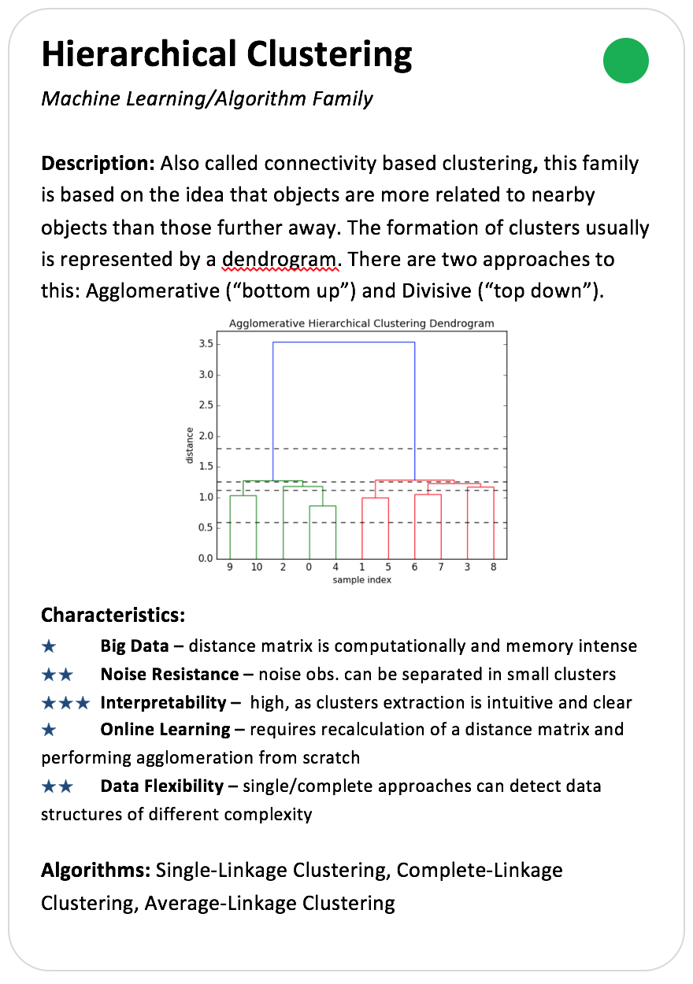
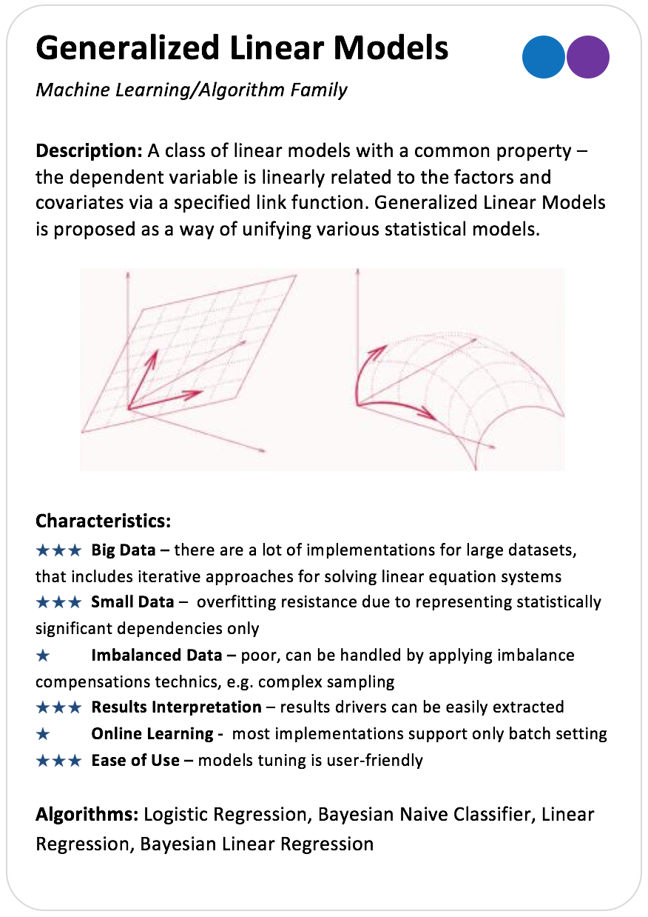
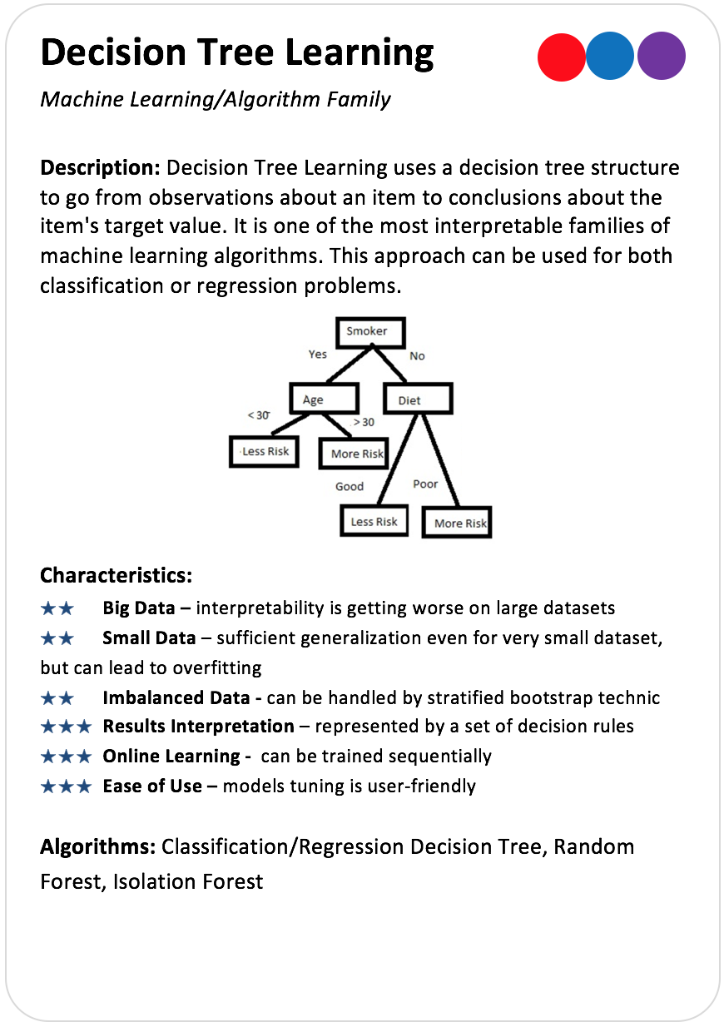
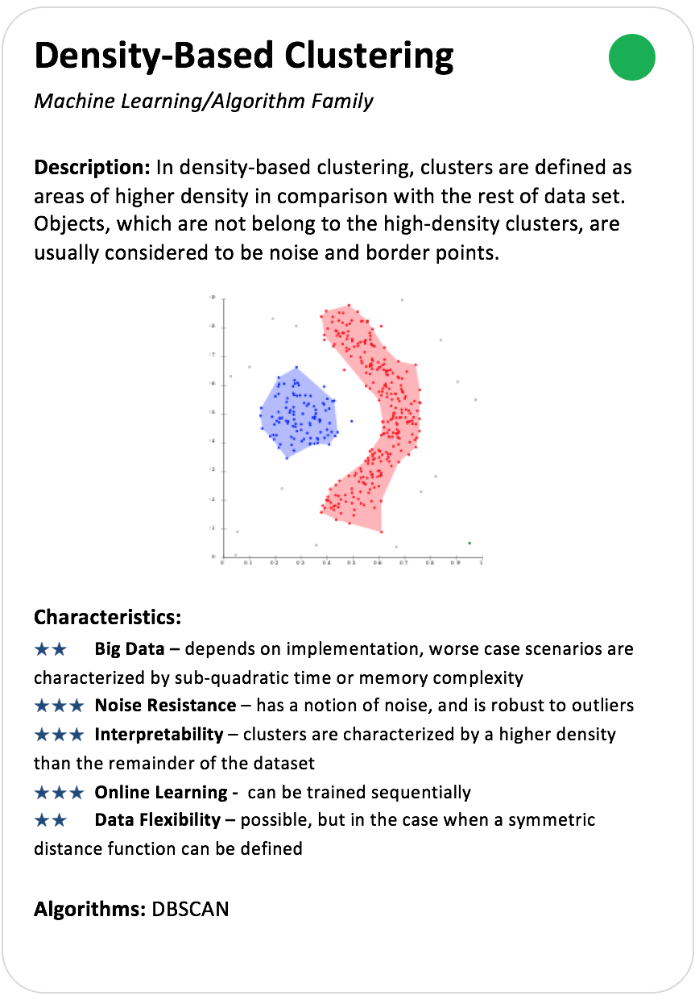
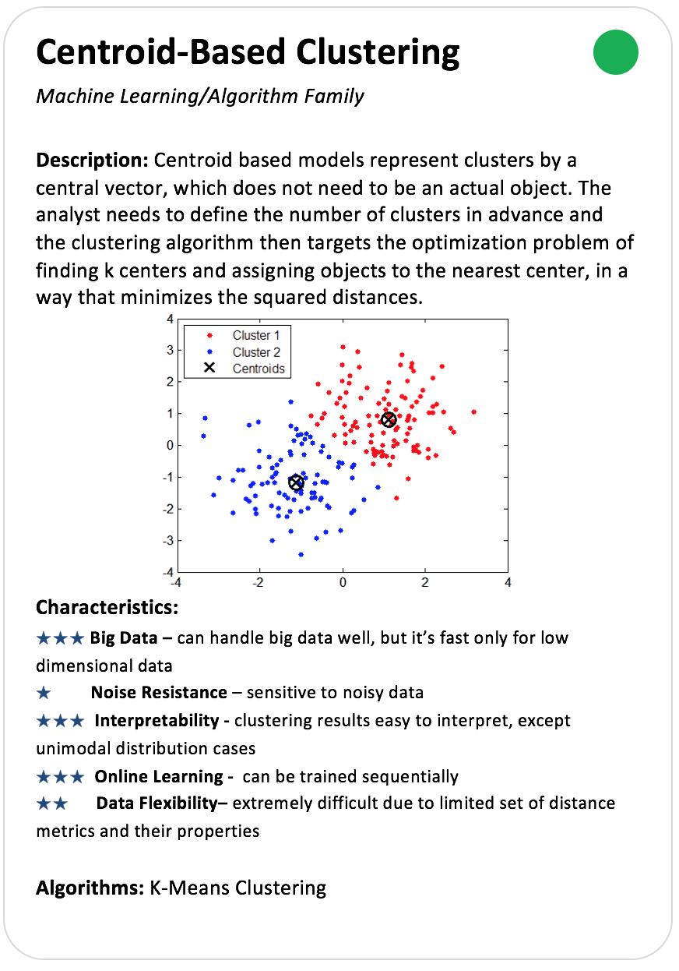
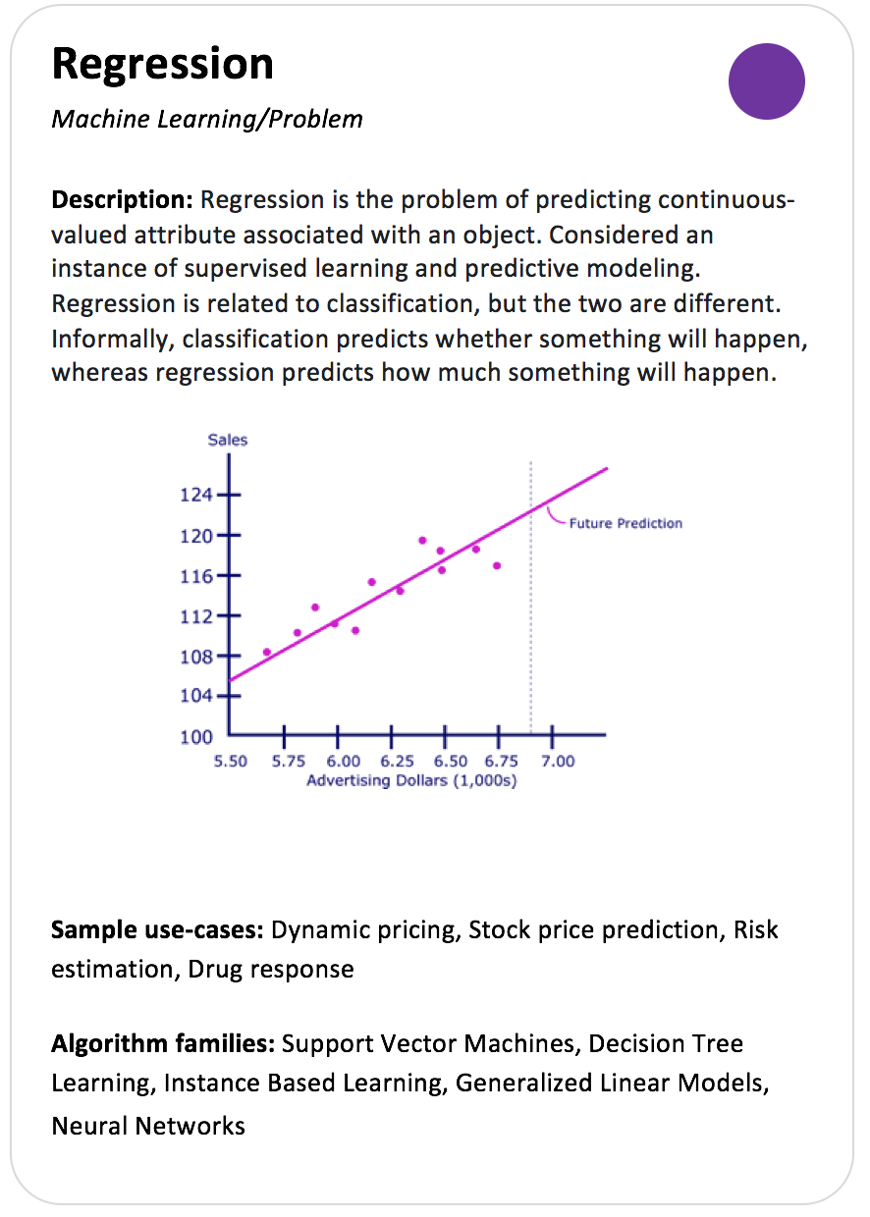
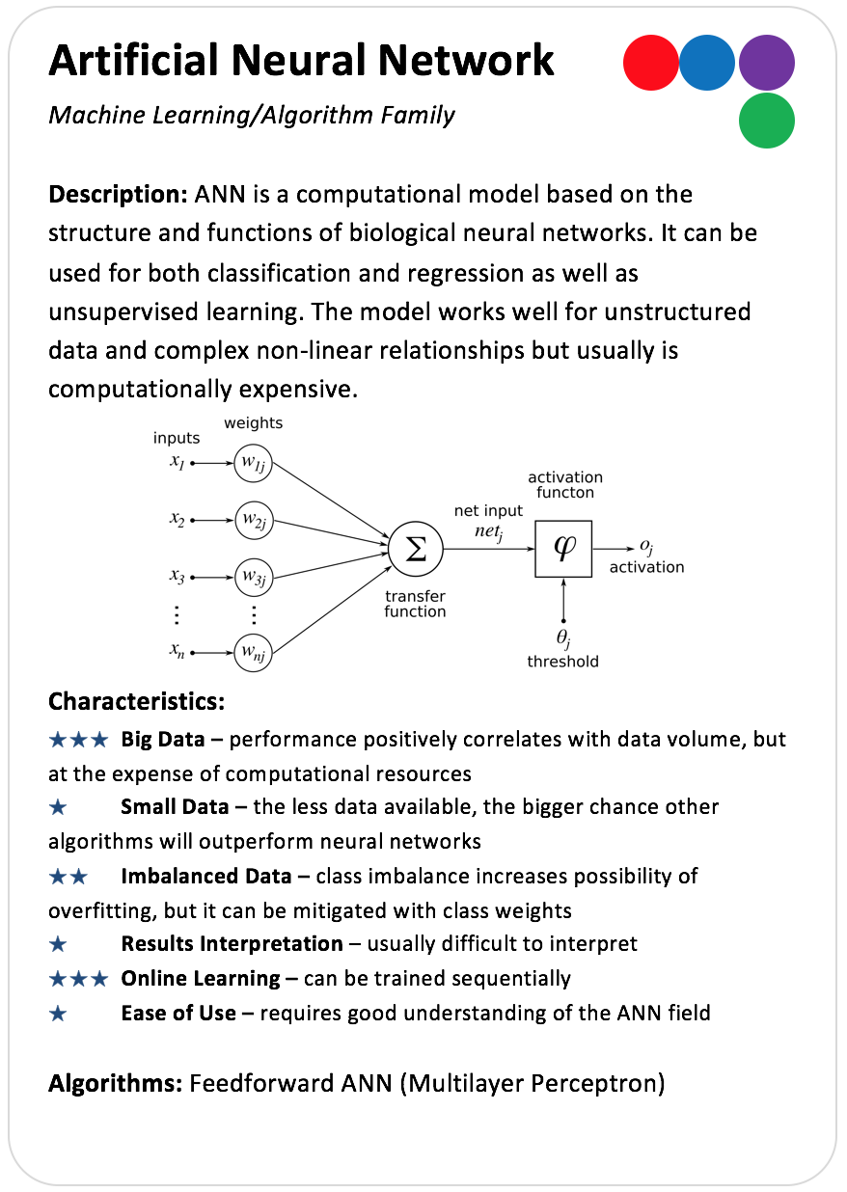
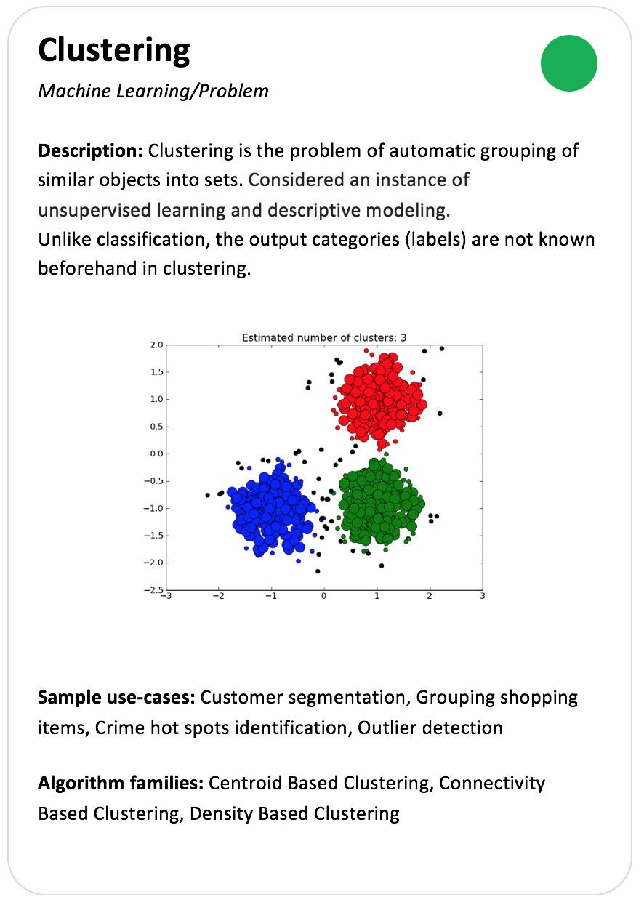
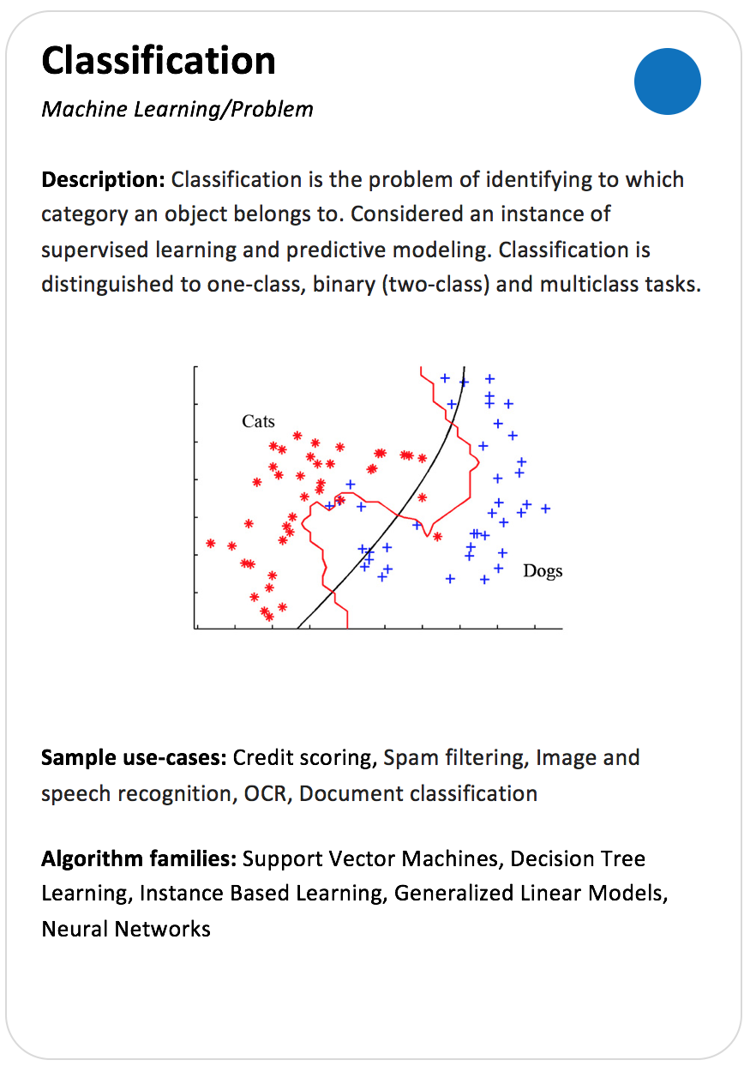
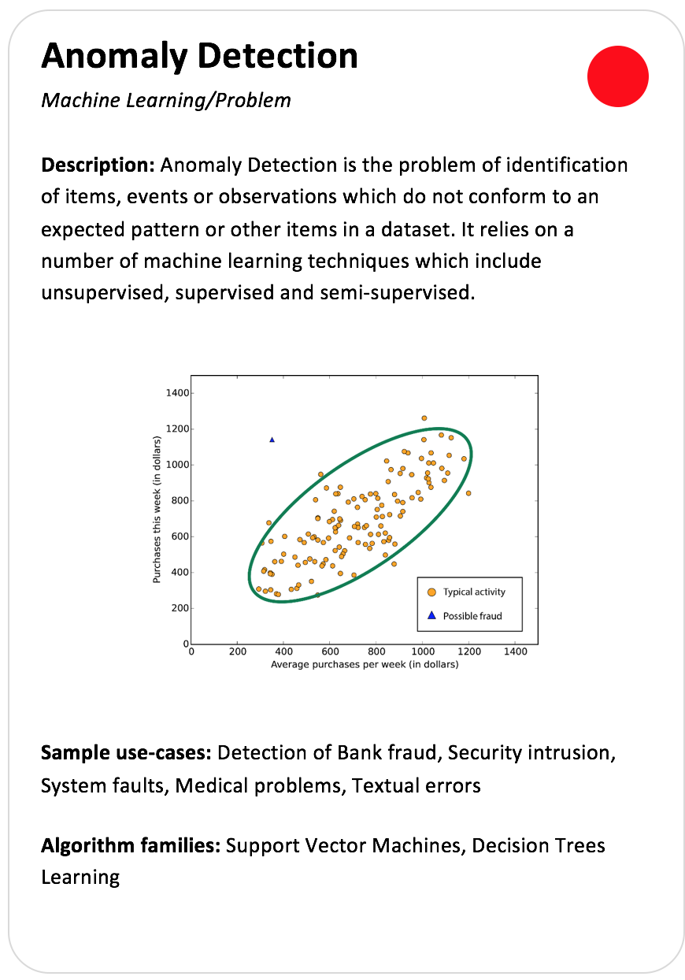
Machine Learning Poker
Problem | Algorithm Family | Algorithm
Data Mining problem based on the desired output of a machine-learned system | Group of algorithms that are united by common approach to the extraction and generalization of dependencies inside analyzed data | Cards describe separate Machine learning algorithms with the specific of their application, including pros and cons

Slide 3
ML Cards: Data Mining Problems
Prediction of the continuous-valued attribute associated with an object
Recognition of the discrete category, which an object belongs to
identification of items (events) which do not conform to an expected patterns
Automatic grouping of similar objects into sets

Slide 4
ML Cards: Algorithms Family
Drivers
Big Data
Small Data
Online Learning
Easy of Use
Results Interpretation
Data Flexibility
Imbalanced Data
Noise Resistance
Group of algorithms that are united by common approach to the extraction and generalization of dependencies inside analyzed data
AF Name and Problems Markers
General Descriptions, which reflects the common features of the Algorithms form this group
Common Drivers of the Algorithms form this group
Algorithms that belong to the group

Slide 5
ML Cards: Algorithm
Drivers
Accuracy
Training Speed/Time Complexity
Prediction Speed
Overfitting Resistance
Memory Complexity
Deterministic Results (Clustering)
Probabilistic Interpretation
Tuning Complexity
Cards describe separate Machine learning algorithms with the specific of their application, including pros and cons
Algorithm Name and Problems Markers
General Descriptions, which reflects the specific of particular algorithm
Particular Drivers of the Algorithm, which vary for different Algorithms Families
Important Tips – may help you for make a right choise

Slide 6
ML Cards: Algorithms

Slide 7
ML Cards: SVM Family

Slide 8
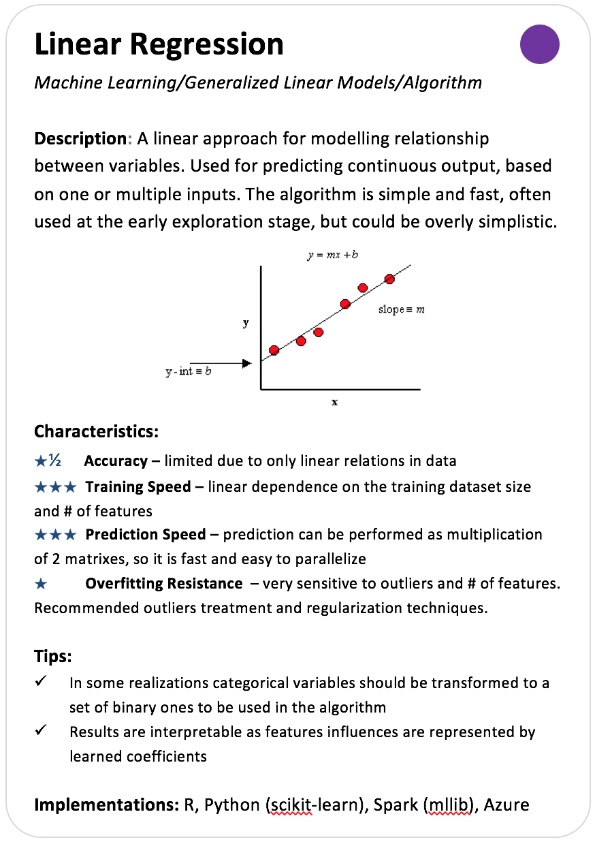
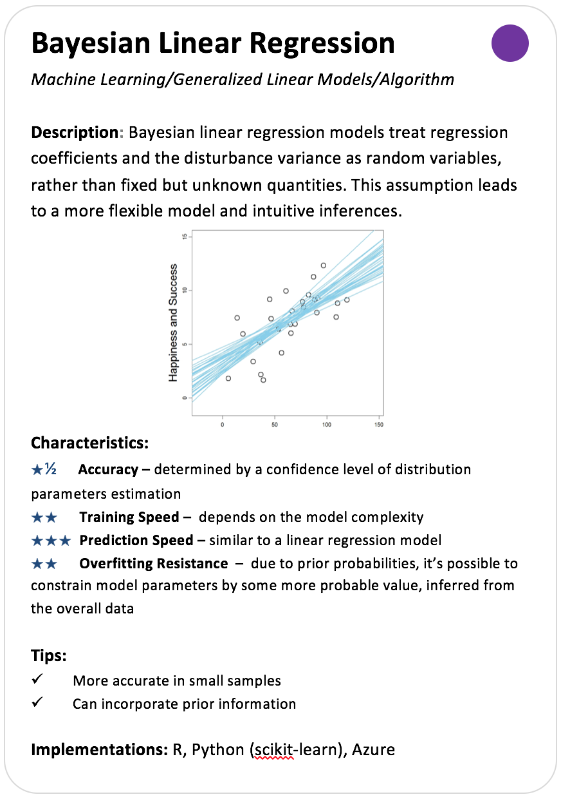
ML Cards: Generalized Liner Models

Slide 9
ML Cards: Instance-Based Learning

Slide 10
ML Cards: Decision Tree Learning

Slide 11
ML Cards: Hierarchical Clustering

Slide 12
ML Cards: Density and Centroid Based Clustering

Slide 13
ML Cards: Artificial Neural Network

Slide 14
ML Playground

Slide 15
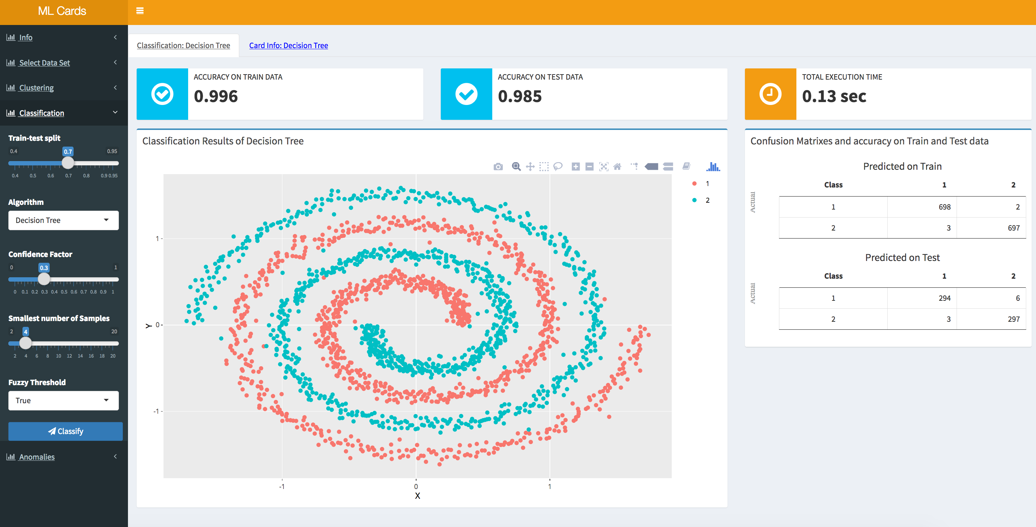
ML Playground
How To Play
1. Select DataSet.
2. Data Mining Problem Solving:
Clustering:
a. Hierarchical clustering
b. K-Means
c. DBScan
Classification:
a. Decision Tree
b. Random Forest
c. Linear and non-Linear SVMs
d. Logistic Regression
e. Bayesian Naive Classifier
f. k-Nearest Neighbors
g. Radius Neighbors
h. Multi-Layer Perceptron
Anomaly Detection:
a. One-Class SVM
b. Iforest
https://fireflyty.shinyapps.io/mlcards/

Slide 16
Thank You!

